Slide 1
W4111 – Introduction to Databases Section 003, V03, Fall 2024 Lecture 1: Introduction and Foundational Concepts
© Donald F. Ferguson, 2024

Slide 2

W4111 – Introduction to Databases Section 003, V03, Fall 2024 Lecture 1: Introduction and Foundational Concepts
We will start in a few minutes.
If you ask me about the waitlist, I will become very grumpy.
© Donald F. Ferguson, 2024

Slide 3

W4111 Introduction to Databases:
Faculty do not manage waitlists for some courses, including W4111.
The academic admin staff in the CS Department manages the waitlist, priorities and enrollment.
You should contact advising email:
ug-advising, ms-advising, or phd-advising @cs.columbia.edu
3 | COMS W4111_003_2024_3: Lecture 1: Introduction, Course Overview, Foundational Concepts © Donald F. Ferguson, 2024

Slide 4
Today’s Contents
4 | COMS W4111_003_2024_3: Lecture 1: Introduction, Course Overview, Foundational Concepts © Donald F. Ferguson, 2024

Slide 5
Contents
Introduction
Logistics, about your instructor, OHs, IAs.
Homework, exams.
Data, Databases, Database Management Systems, Applications
Motivating Examples:
Interactive, web application.
Data analysis and visualization.
Database design, Entity-Relationship Model (Part 1)
Database design process.
ER-Model and diagrams.
The theory: The Relational Model (Part 1)
Relational model, schema, keys, schema diagrams.
Basics of relational algebra.
The realization: Structured Query Language (SQL) (Part 1)
Basics of Data Definition Language.
Basics of Data Manipulation Language (Query).
Homework 1 – (Initial) Definition and discussion.
The material is mostly
History of databases
Motivation for databases
Terms
Concepts
Covering in lecture is not a good use of time.
Just read slides that come with book. https://www.db-book.com/slides-dir/index.html
Homework assignments and exams will test knowledge and if you have reviewed material.

Slide 6
Introduction
6 | COMS W4111_003_2024_3: Lecture 1: Introduction, Course Overview, Foundational Concepts © Donald F. Ferguson, 2024

Slide 7

Logistics
7 | COMS W4111_003_2024_3: Lecture 1: Introduction, Course Overview, Foundational Concepts © Donald F. Ferguson, 2024

Slide 8
Lecture Format, Recitation, Office Hours
Sessions:
Lecture: (In-Person) Lecture: Friday, 10:10AM to 12:40PM (309 Havemeyer).
Office hours: Fridays, 8:30AM – 10:00 and 4:00 PM to 5:00 PM (488 CSB)
Extra office hours: I hold a lot of extra office hours, usually online, and based on workload around assignment due dates and exams.
I have a Zoom meeting and record all lectures and office hours.
Collaboration/contact:
We will use Ed Discussions for collaboration and communication. This is available from the side navigation menu on CourseWorks.
The course lectures, sample code, etc. will be in a GitHub repository.
The course website provides additional information. (In progress)
There will be a course calendar with OHs, assignments, exams, … … (In progress)
Note: Your health, safety and well-being are ALWAYS my primary concern. Speak to me if you need special considerations and I will do the best that I can.

Slide 9
About Your Instructor
9 | COMS W4111_003_2024_3: Lecture 1: Introduction, Course Overview, Foundational Concepts © Donald F. Ferguson, 2024

Slide 10

About your Instructor
38 years in computer science industry:
IBM Fellow.
Microsoft Technical Fellow.
Chief Technology Officer, CA technologies.
Dell Senior Technical Fellow.
CTO, Co-Founder, Seeka.tv.
Ansys (current):
Ansys Fellow, Chief SW Architect;
VP/GM, Cloud, AI, Solutions and Developer Enablement BU (CASEBU)
Academic experience:
BA, MS, Ph.D., Computer Science, Columbia University.
Approx. 18 semesters as an Adjunct Professor.
Professor of Professional Practice in CS (2018)
Courses:
E1006: Intro. to Computing
W4111: Intro. to Databases
E6998, E6156: Advanced Topics in SW Engineering (Cloud Computing)
Approx. 65 technical publications; Approx. 12 patents.
Personal:
Two children:
College Sophomore.
2019 Barnard Graduate.
Hobbies:
Krav Maga, Black Belt in Kenpo Karate.
Former 1LT, New York Guard.
Bicycling.
Astronomy.
Languages:
Proficient in Spanish.
Learning Arabic.
I have taught some version of this class 10 times.

Slide 11
About the Course
11 | COMS W4111_003_2024_3: Lecture 1: Introduction, Course Overview, Foundational Concepts © Donald F. Ferguson, 2024

Slide 12
The Course
From the new/pending Columbia University Bulletin "Prerequisites: COMS W3134, COMS W3136, or COMS W3137; or the instructor's permission. The course covers what a database system is, how to design databases effectively and in a principled manner, how to query databases, and how to develop applications using databases: entity-relationship modeling, logical design of relational databases, relational algebra, SQL, database application development, database security, and an overview of query optimization and transaction processing. Additional topics generally include NoSQL, graph, object-relational, and cloud databases, as well as data preparation and cleaning of real-world data. The course offers both programming and non-programming paths for homework and projects, to accommodate students with different programming skills and backgrounds."
Prerequisites:
COMS W3134, COMS W3136, or COMS W3137 are data structures classes. All of these courses require extensive programming, in Java.
A course in data structures is helpful for this section of W4111 but not essential. I waive the requirement.
We will help you with any data structures knowledge you lack.
Programming in/for this class:
There will be a "non-programming" option, which we will discuss below.
For students who want to take the programming track, we will use Python. I will provide motivation for choosing Python below.

Slide 13
Course Objectives
Have fun, learn a lot and come to appreciate and enjoy some amazing technology. Data and databases have and will change the world.
Provide a foundation that allows you to succeed in future courses. This is an introduction to databases. The technology is crucial for future courses
Big data, data analysis, data science
Advanced database classes
Machine learning
Numerical and data analytics in operations research, engineering, economics, finance, life sciences, financial engineering, medicine, etc.
Enable you to successfully apply the technology in your work and profession.
Have cool stuff to talk about on interviews and in your resumes.

Slide 14
The Course – Value and my Perspective
This course is foundational, and will teach you the core concepts in
Data modeling
Data model implementation; Data manipulation.
Different database models and database management systems.
Implementation and architecture of data centric applications and database management systems.
ANY non-trivial application
Requires a well-designed data model.
Implements a data model and manipulates data.
Uses a database management system.
Understanding databases and database management is core to the “hottest fields” in computer science, e.g.
Data science
Machine learning
Intelligent (Autonomous) systems
Internet-of-Things
Cybersecurity
Cloud Computing
Database, database application, etc. skills are increasingly central to many disciplines, including:
Economics.
IEOR, financial engineering.
Mechanical and electrical engineering.
Medicine, pharmaceuticals
...
University courses on databases sometimes focus on theory and abstract concepts. This course will cover theory, but there will be an increased emphasis on:
Practical, hands-on applications of databases.
Patterns and best practices.
Developing and understanding database centric applications.
Using databases and various tools for data analysis, visualization and insight.
Personal perspective
A large percent of my career has been spent figuring out or leading teams that figured out how to model, implement and manipulate data.
I have used the information in this class more than anything else I have learned.
This will likely be true for you.

Slide 15
Surprising Example
Example: This is a photo of me using a database during COVID-19 mobilization.
Match service members
To JTF-HQ requests for personnel
Based on assignment needs
And service member
Skills
Availability
Tracked in a DBMS.
The hardhat is because DB usage can be very dangerous 😱.
No joking: I had to build an application that used:
Relational DBMS.
Python, Jupyter Notebook.
Google Sheets with Apps Script.
Google Forms.
This course’s technology and these skills are surprisingly applicable.

Slide 16
Modules
Each section of W4111 is slightly different based on student interest and professor's focus. There is a common, core syllabus. Professors cover topics in different orders and grouping based on teaching style.
This section of W4111 has four modules:
Foundational concepts (50% of semester): This module covers concepts like data models, relational model, relational databases and applications, schema, normalization, … The module focuses on the relational model and relational databases. The concepts are critical and foundational for all types of databases and data centric applications.
Database management system architecture and implementation (10%): This module covers the software architecture, algorithms and implementation techniques that allow databases management systems to deliver functions. Topics include memory hierarchy, storage systems, caching/buffer pools, indexes, query processing, query optimization, transaction processing, isolation and concurrency control.
NoSQL – “Not Only SQL” databases (20%): This module provides motivation for “NoSQL” data models and databases, and covers examples and use cases. The module also includes cloud databases and databases-as-a-service.
Data Enabled Decision Support (20%): This module covers data warehouses, data import and cleanse, OLAP, Pivot Tables, Star Schema, reporting and visualization, and provides and overview of analysis techniques, e.g. clustering, classification, analysis, mining.

Slide 17
Environment
17 | COMS W4111_003_2024_3: Lecture 1: Introduction, Course Overview, Foundational Concepts © Donald F. Ferguson, 2024

Slide 18
Course Resources and Development Environment
Recommended textbook:
Database System Concepts. Seventh Edition. (ISBN 9780078022159)
There is a website associated with the textbook: https://www.db-book.com/. The site has:
Slides for each chapter.
Example data.
Textbooks are expensive. You can easily get through the course using website, lecture material, ... ...
Install a new, most recent, isolated/single user instance of Anaconda environment.
Install just for yourself and within your home directory.
You must install the most recent version for Python 3.
You can isolate the new instance from other instances to avoid conflicts, or set up custom environments.
Development environments: Students are entitled to a free, annual JetBrains professional license.
Students have had problems with MySQL Workbench. We will use DataGrip. Please install.
Installing PyCharm is recommended for all and required for the programming track.
Install MySQL Server Community Edition.
When prompted, choose legacy authentication method.
Set your root password to dbuserdbuser. (Remember your user name and password)

Slide 19
Homework Exams
Grading
19 | COMS W4111_003_2024_3: Lecture 1: Introduction, Course Overview, Foundational Concepts © Donald F. Ferguson, 2024

Slide 20
Assignments, Exams, Grading
To be updated.

Slide 21
To Program or Not To Program, ...
From the department's guidance for the course:
"To accommodate the diverse backgrounds of the students who take this class, all sections of the class should include a non-programming option for projects and assignments. We (NOTE: Does not include me) have successfully offered such an option in some sections of the class for many years: students can either program a web application to interface with a DB of their own design, or alternatively follow the non-programming option and come up with a quantifiably more detailed DB design/data.
What does not constitute programming?
Writing queries for a relational, graph, document, or other data management system does not constitute programming and can be expected of all students.
What constitutes programming?
Reading more than a handful (1-5) lines of code, Writing Python code that is not directly required to write a query."
Why I previous only did a programming track:
Any non-trivial use of data and databases in any field requires programming. This is not Star Trek. You cannot shout, "Computer! Analyze ..."
You might think, "But, I do not want to program. I want to go into financial services, private equity, medicine, ... I can just use tools like Pandas or Tableau”. You will do some programming in these jobs for complex scenarios. Get over it.
Tracks: Programming and non-programming.
There is a common core that involves understanding concepts, modeling data, using databases, etc.
Exams are the same for both tracks. Mix of written questions and practical exercises.
Homework assignments: There is a common core on all assignments for both tracks. Additionally,
Programming track will incrementally build a database centric, cloud-based web application.
Non-programming track will do a more complex, database centric project.

Slide 22
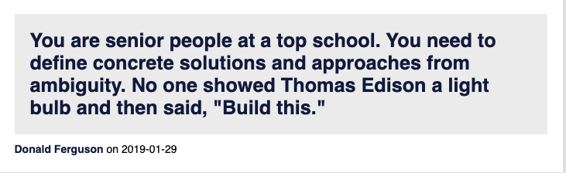
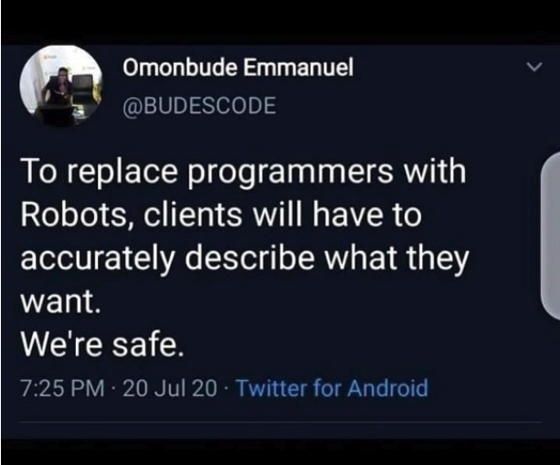
Homework Assignments
My homework assignments are:
Open ended.
Vaguely specified.
You will complain. I will listen sympathetically.
You will savage me on the instructor reviews and CULPA.
My professional colleagues and I will laugh at you behind your back.
Management, clients, partners, etc.
Do not understand technology as well as we do.
You will get requirements like, “I want it colored mauve because that has more RAM.”
Converting vague requests into a useful, meaningful project that we can implement is what we do. Get over it.

Slide 23
Database Applications
23 | COMS W4111_003_2024_3: Lecture 1: Introduction, Course Overview, Foundational Concepts © Donald F. Ferguson, 2024

Slide 24
Two Common Database Applications
Operational/Interactive:
Users and roles can create, retrieve, update, search and delete “records.”
Examples: SSOL, ATMs, … …
Business Intelligence, Decision Support, …:
Users can perform complex queries and analyze a lot of data to generate a report, make a decision, … …
Examples: Build AI/ML training data, dashboards, … …
Some of our major datasets this semester will be:
IMDB: https://developer.imdb.com/non-commercial-datasets/
Game of Thrones: https://developer.imdb.com/non-commercial-datasets/
Lahman’s Baseball Dataset: http://seanlahman.com/
… …
We will build a simple web application and do some data engineering.

Slide 25
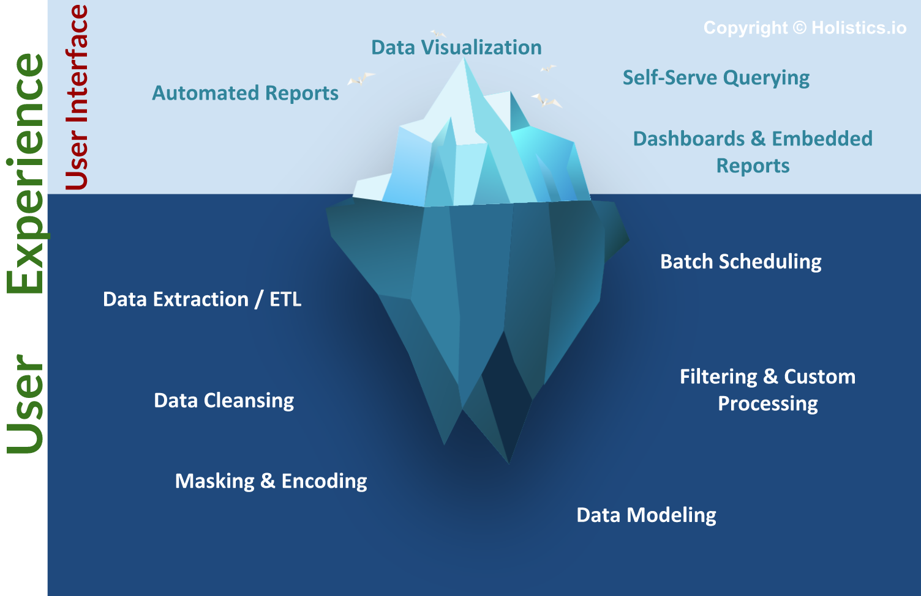
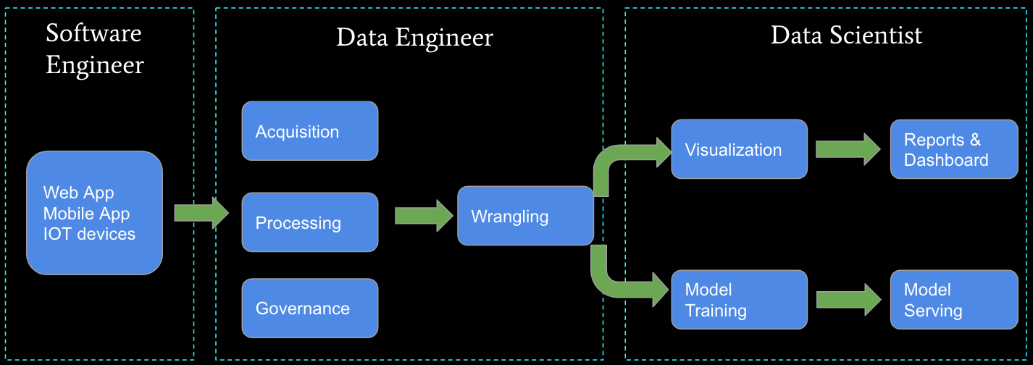
Business Intelligence, Insight, Analysis, … …
The “fun” stuff in data science and AI/ML is the “tip of the iceberg.”
Data engineering is a necessary condition for producing analyzable data. This is often more than 80% of the hard work.
We will do some small data engineering projects in this course.

Slide 26
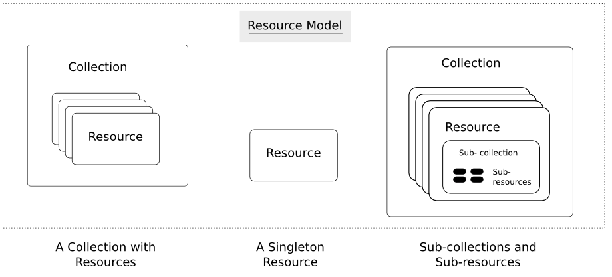
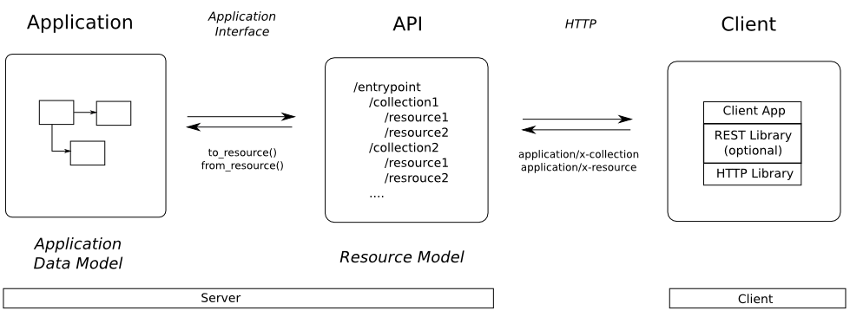
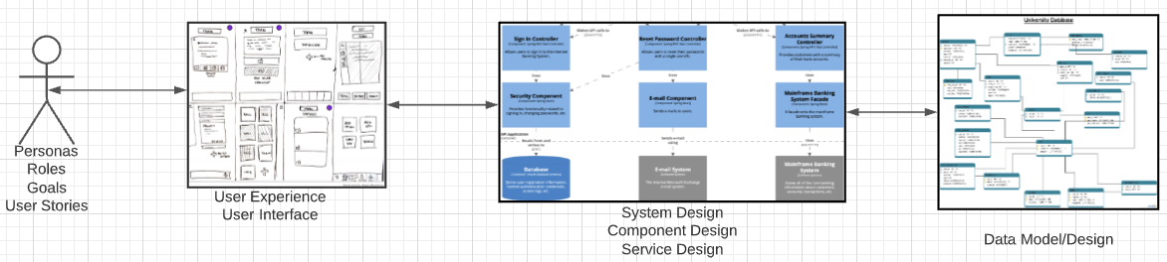
Web Application Problem Statement
We must build a system that supports create, retrieve, update and delete for IMDB and Game of Thrones Datasets.
This requires implementing create, retrieve, update and delete (CRUD) for resources.
We will design, develop, test and deploy the system iteratively and continuously.
There are four core domains.
https://restful-api-design.readthedocs.io/en/latest/resources.html
In this course,
We focus on the data dimension.
We will get some insight into the other dimensions.

Slide 27
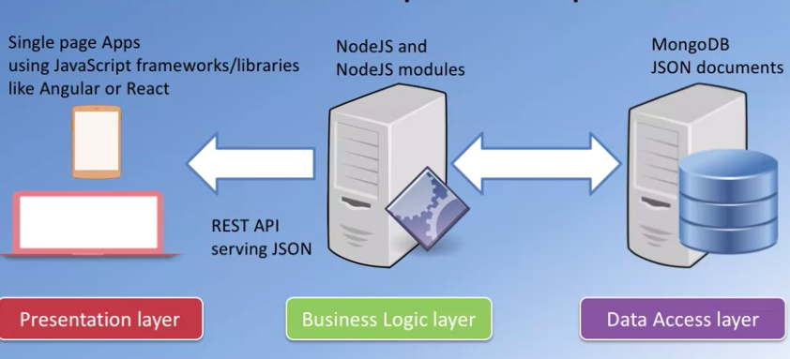
Interactive/Operational
“A full stack web developer is a person who can develop both client and server software. In addition to mastering HTML and CSS, he/she also knows how to:
Program a browser (like using JavaScript, jQuery, Angular, or Vue)
Program a server (like using PHP, ASP, Python, or Node)
Program a database (like using SQL, SQLite, or MongoDB)”
https://www.w3schools.com/whatis/whatis_fullstack.asp
We will do a simple full stack app.
Three databases:
MySQL
MongoDB
Neo4j
The application tier will be Python and FastAPI.
The web UI will be Angular.
The primary focus is the data layer and application layer that access it.
I will provide a simple UI and template.

Slide 28
Approach for First Few Lectures
28 | COMS W4111_003_2024_3: Lecture 1: Introduction, Course Overview, Foundational Concepts © Donald F. Ferguson, 2024

Slide 29
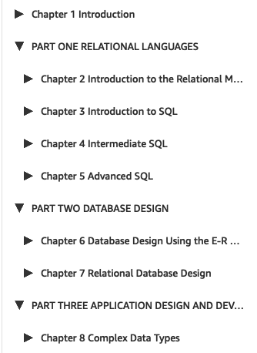
Lectures and Topics
Chapter 1:
Is interesting, but something easily learned from reading slides, docs, etc.
You are responsible for reading the slides and independent study.
Books and standard syllabuses tend to be sequential. Cover and complete topics one at a time.
My view is that there is a core conceptual model with three realizations:
Entity, relationships, ... ...; the concepts.
ER design and modeling.
Implementation:
Relational model/algebra.
SQL.
Resource/REST oriented.
… …
My approach is to incrementally and iteratively:
Introduce concepts.
Explain the realizations.
Because implementing a real system requires the approach of concept, design, implement in several layers.

Slide 30
Database Modeling, ER Modeling (I)
30 | COMS W4111_003_2024_3: Lecture 1: Introduction, Course Overview, Foundational Concepts © Donald F. Ferguson, 2024

Slide 31
Design Phases
Initial phase -- characterize fully the data needs of the prospective database users.
Second phase -- choosing a data model
Applying the concepts of the chosen data model
Translating these requirements into a conceptual schema of the database.
A fully developed conceptual schema indicates the functional requirements of the enterprise.
Describe the kinds of operations (or transactions) that will be performed on the data.
DFF Comments:
We you see slides with this formatting, the come directly from the presentations associated with the textbook. (https://www.db-book.com/db7/slides-dir/index.html)
The number at the bottom is of the form chapter.slide_no.
I try to put my comments, modifications and annotations in red text, or inside a red rectangle/callout.

Slide 32
Design Phases (Cont.)
Final Phase -- Moving from an abstract data model to the implementation of the database
Logical Design – Deciding on the database schema. Database design requires that we find a “good” collection of relation schemas.
Business decision – What attributes should we record in the database?
Computer Science decision – What relation schemas should we have and how should the attributes be distributed among the various relation schemas?
Physical Design – Deciding on the physical layout of the database
Notes:
32

Slide 33

A Common and my Approach: Conceptual → Logical → Physical
https://ehikioya.com/conceptual-logical-physical-database-modeling/
https://www.1keydata.com/datawarehousing/data-modeling-levels.html
It is easy to get carried away with modeling. You can spend all your time modeling and not actually build the schema.
We will use the approaches in class.
Mostly to understand concepts and patterns.
https://www.1keydata.com/datawarehousing/data-modeling-levels.html

Slide 34
ER model -- Database Modeling
The ER data mode was developed to facilitate database design by allowing specification of an enterprise schema that represents the overall logical structure of a database.
The ER data model employs three basic concepts:
entity sets,
relationship sets,
attributes.
The ER model also has an associated diagrammatic representation, the ER diagram, which can express the overall logical structure of a database graphically.

Slide 35
Entity Sets
COMS W4111 002 01 2024
An entity is an object that exists and is distinguishable from other objects.
Example: specific person, company, event, plant
An entity set is a set of entities of the same type that share the same properties.
Example: set of all persons, companies, trees, holidays
An entity is represented by a set of attributes; i.e., descriptive properties possessed by all members of an entity set.
Example:
instructor = (ID, name, salary ) course= (course_id, title, credits)
A subset of the attributes form a primary key of the entity set; i.e., uniquely identifying each member of the set.
DFF Comments:
Some of these statements apply primarily to OO systems and the relational/SQL models.
A motivation for “No SQL” is to relax the constraints.

Slide 36
Entity Sets -- instructor and student
(10101, 98988)
(10101,76543)

Slide 37
Relationship Sets
A relationship is an association among several entities
Example: 44553 (Peltier) advisor 22222 (Einstein) student entity relationship set instructor entity
A relationship set is a mathematical relation among n ≥ 2 entities, each taken from entity sets
{(e₁, e₂, … e_{n}) | e₁ ∈ E₁, e₂ ∈ E₂, …, e_{n} ∈ E_{n}} where (e₁, e₂, …, e_{n}) is a relationship
Example:
(44553,22222) ∈ advisor
DFF Comments:
Nobody thinks about relationships this way.
There is no idea so simple that a DB professor cannot make it confusing, usually by using math.

Slide 38
Relationship Sets (Cont.)
Example: we define the relationship set advisor to denote the associations between students and the instructors who act as their advisors.
Pictorially, we draw a line between related entities.
DFF Comment:
In this diagram, the lines are the relationship set.
Many DB models use a 3rd entity set to represent complex relationships.
DFF Comments:
Nobody draws the diagrams this way, but ...
Sometimes thinking this way helps understand other ways to depict the concept.

Slide 39

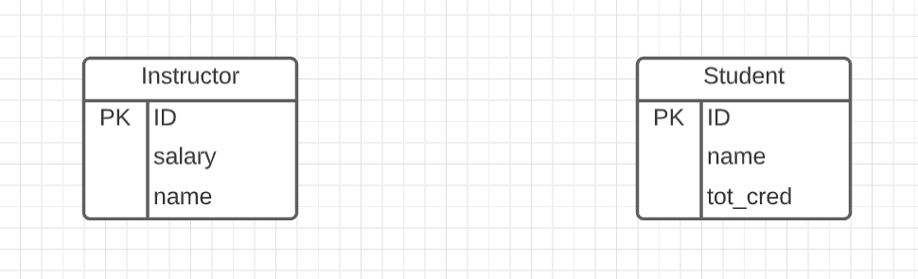
Representing Entity sets in ER Diagram
Entity sets can be represented graphically as follows:
Rectangles represent entity sets.
Attributes listed inside entity rectangle
Underline indicates primary key attributes
“Visual modeling is the use of semantically rich, graphical and textual design notations to capture software designs. A notation, such as UML, allows the level of abstraction to be raised, while maintaining rigorous syntax and semantics. In this way, it improves communication in the design team, as the design is formed and reviewed, allowing the reader to reason about the design, and it provides an unambiguous basis for implementation.”
Crow’s Foot Notation

Slide 40
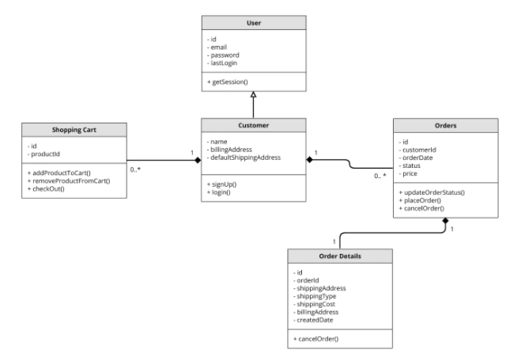
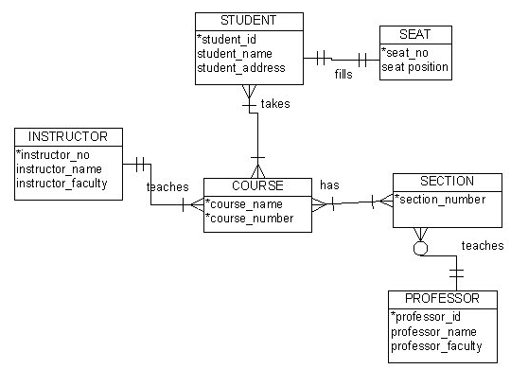
Visual Notation – Many Notations
ER Model
UML
“Other,” i.e. PowerPoint is the most common modeling notation.
It is easy to get “carried away.”
The trick is to do “just enough modeling.”
I mostly use Crow’s Foot
It is “just enough”
But lacks some capabilities.
The book uses ER notation.
Crow’s Foot

Slide 41
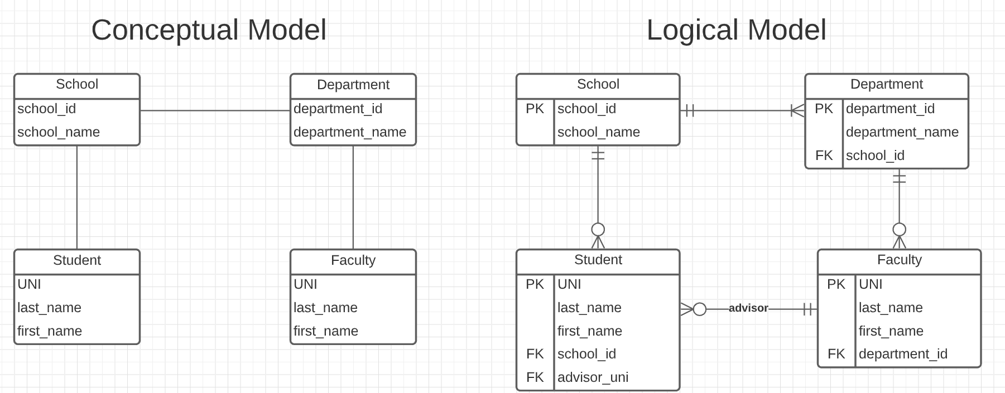
Do a Slightly More complex University Database ER Model
The model has:
Four entity sets:
School
Department
Student
Faculty
Three relationship sets:
Student-School
School-Department
Faculty-Department.
This is the level of detail I want when I ask for:
Conceptual Model diagram.
Logical Model diagram.
Some online tools with “free,” constrained usage.
Lucidchart (https://www.lucidchart.com/)
Vertabelo (https://vertabelo.com/)

Slide 42
Notation has Precise Meaning
Attribute annotations:
PK = Primary Key
FK = Foreign Key
Line annotations:
We will learn over time and there are good tutorials (https://www.lucidchart.com/pages/er-diagrams) to help study and refresh.
We will spend a lot of time discussing keys.
We will start in a couple of slides.

Slide 43
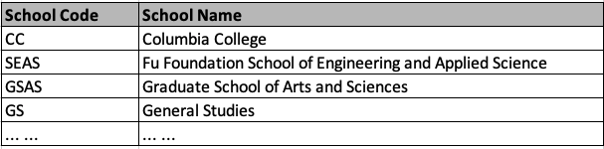
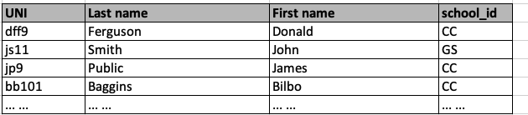
What Does this Mean? Let’s Get Started
Primary Key means that the value occurs at most once.
This is a statement about the domain, not the actual data currently in the table.
Foreign Key means that if a value occurs in school_id for any row, there must be a row in School with that key.
The line notations mean:
A student is related to EXACTLY ONE school.
A School may be related to 0, 1 or many students.

Slide 44
ER model -- Database Modeling
The ER data mode was developed to facilitate database design by allowing specification of an enterprise schema that represents the overall logical structure of a database.
The ER data model employs three basic concepts:
entity sets,
relationship sets,
attributes.
The ER model also has an associated diagrammatic representation, the ER diagram, which can express the overall logical structure of a database graphically.
DFF Comments:
The book and slides do not do a great job of motivating the ER model or ER diagrams.
Why do people and teams think about or use the ER model and modeling?

Slide 45

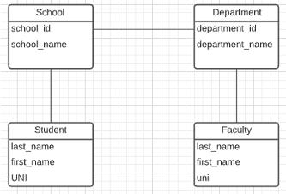
ER Model and ER Modeling
ER Model
Generalization
ER Model: Agility, Separation of Concerns
ER model is a generalization that most DB models implement in some form.
Using the ER model enables:
Thinking about and collaborating on design with getting bogged down in details.
Enable flexible choices about how to realize/Implement data.
ER Diagrams: Communication, Quality, Precision
With a little experience, everyone can understand and ER diagram.
Easier to discuss and collaborate on application’s data than showing SQL table definitions, JSON, ... ...
People think visually. That is why we have whiteboards. ER diagrams are precise and unambiguous.
Guides you to think about relationships, keys, ... And prevents “re-dos” later in the process. It is easier to fix a diagram than a database schema.
Specialization
Relational
Doc Model
Graph Model
... ...
UI UX
Business Professional
Business Service Developer
DB Pros

Slide 46
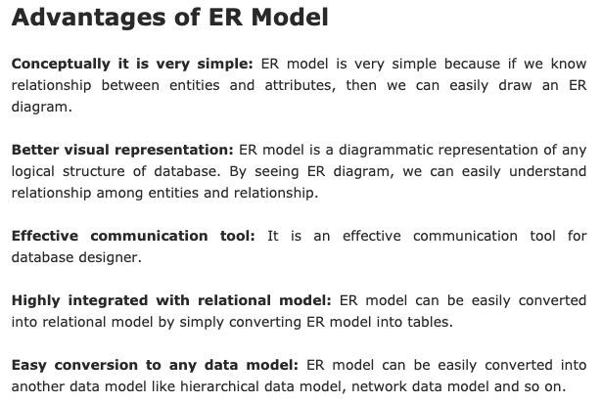
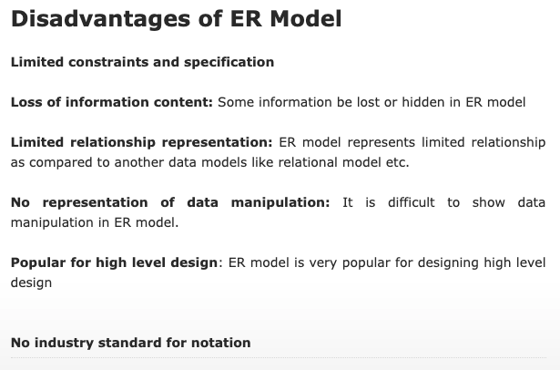
ER Modeling – Reasonably Good Summary
https://pctechnicalpro.blogspot.com/2017/04/advantages-disadvantages-er-model-dbms.html
Note:
If you get to use Google to help with take home exams, HW, etc.
I get to use Google to help with slides.

Slide 47
Theory: Relational Model (I)
47 | COMS W4111_003_2024_3: Lecture 1: Introduction, Course Overview, Foundational Concepts © Donald F. Ferguson, 2024

Slide 48
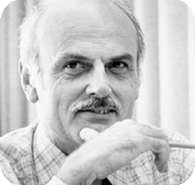

Relational Model
All the data is stored in various tables.
Example of tabular data in the relational model
Columns
Ted Codd Turing Award 1981
The “relation” is the “table.”
In my big space of pieces of data. ID, name, dept_name, salary are somehow related.
This causes confusion, because the ER and other models use “relation” to mean something else.
Core concepts:
Relation
Tuple (Row)
Column (Attribute)
Rows
Notes:
48

Slide 49

Example of a Instructor Relation
attributes
(or columns)
00123
123
tuples
(or rows)
Integer
-213
(integers, >0 )

Slide 50
Attribute
The set of allowed values for each attribute is called the domain of the attribute
Attribute values are (normally) required to be atomic; that is, indivisible
The special value null is a member of every domain. Indicated that the value is “unknown”
The null value causes complications in the definition of many operations
COMSW4111
Ferguson, Donald
Ferguson
Donald
DFF Comments:
I will explain the importance of atomic attributes and null in examples.
Atomic and use of Null is important!

Slide 51

Relations are Unordered
Order of tuples is irrelevant (tuples may be stored in an arbitrary order)
Example: instructor relation with unordered tuples

Slide 52
Database Schema
Database schema -- is the logical structure of the database.
Database instance -- is a snapshot of the data in the database at a given instant in time.
Example:
schema: instructor (ID, name, dept_name, salary)
Instance:
instructor (ID, name, dept_name, salary)

Slide 53
Keys
Let K ⊆ R
K is a superkey of R if values for K are sufficient to identify a unique tuple of each possible relation r(R)
Example: {ID} and {ID,name} are both superkeys of instructor.
Superkey K is a candidate key if K is minimal Example: {ID} is a candidate key for Instructor
One of the candidate keys is selected to be the primary key.
which one?
Foreign key constraint: Value in one relation must appear in another
Referencing relation
Referenced relation
Example: dept_name in instructor is a foreign key from instructor referencing department

Slide 54
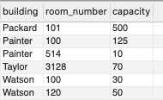
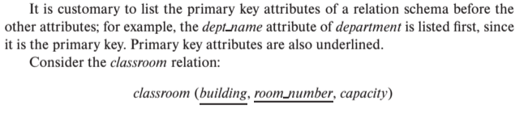
Notation
Classroom relation
classroom schema
Columns (Attributes)
Relation Name
Primary Key Columns
The primary key is a composite key. Neither column is a key (unique) by itself.
Keys are statements about all possible, valid tuples and not just the ones in the relation.
Capacity is unique in this specific data, but clearly not unique for all possible data.
In this domain, there cannot be two classrooms with the same building and room number.
Relation schema:
Underline indicates a primary key column. There is no standard way to indicate other types of key.
We will use bold to indicate foreign keys.
You will sometimes see things like classroom(building:string, room_number:number, capacity:number)

Slide 55
Observations
Keys:
Will be baffling. It takes time and experience to understand/appreciate.
There are many, many types of keys with formal definitions.
I explain the formality but focus on the concepts and applications.
No one uses the formal, relational model. So, why do we study it?
Is very helpful when understanding concepts that we cover later in the course, especially query optimization and processing.
There are many realizations of the model and algebra, and understanding the foundation helps with understanding language/engine capabilities.
The model has helped with innovating new approaches, and you may innovate in data and query models in your future.

Slide 56
Relational Query Languages
Procedural versus non-procedural, or declarative
“Pure” languages:
Relational algebra
Tuple relational calculus
Domain relational calculus
The above 3 pure languages are equivalent in computing power
We will concentrate in this chapter on relational algebra
Not turning-machine equivalent
Consists of 6 basic operations
DFF Comments:
You will sometimes see other operator, e.g. ← Assignment.
Relational algebra focuses on retrieve. You can sort of do Create, Update, Delete.
The SQL Language, which we will see, extends relational algebra.

Slide 57
Relational Algebra
A procedural language consisting of a set of operations that take one or two relations as input and produce a new relation as their result.
Six basic operators
select: σ
project: ∏
union: ∪
set difference: –
Cartesian product: x
rename: ρ

Slide 58

Select Operation
The select operation selects tuples that satisfy a given predicate.
Notation: σ _{p} (r)
p is called the selection predicate
Example: select those tuples of the instructor relation where the instructor is in the “Physics” department.
Query
σ _{dept_name=“Physics”} (instructor)
Result

Slide 59
Select Operation (Cont.)
We allow comparisons using
=, ≠, >, ≥. <. ≤
in the selection predicate.
We can combine several predicates into a larger predicate by using the connectives:
∧ (and), ∨ (or), ¬ (not)
Example: Find the instructors in Physics with a salary greater $90,000, we write:
σ _{dept_name=“Physics”} ∧ _{salary} > 90,000 (instructor)
Then select predicate may include comparisons between two attributes.
Example, find all departments whose name is the same as their building name:
σ _{dept_name=building} (department)

Slide 60
Project Operation
A unary operation that returns its argument relation, with certain attributes left out.
Notation:
∏ _{A1,A2,A3 ….Ak} (r)
where A₁, A₂ are attribute names and r is a relation name.
The result is defined as the relation of k columns obtained by erasing the columns that are not listed
Duplicate rows removed from result, since relations are sets

Slide 61

Project Operation (Cont.)
Example: eliminate the dept_name attribute of instructor
Query: ∏_{ID, name, salary} (instructor)
Result:

Slide 62
Composition of Relational Operations
The result of a relational-algebra operation is relation and therefore of relational-algebra operations can be composed together into a relational-algebra expression.
Consider the query -- Find the names of all instructors in the Physics department.
∏_{name}(σ _{dept_name} _{=“Physics”} (instructor))
Instead of giving the name of a relation as the argument of the projection operation, we give an expression that evaluates to a relation.

Slide 63
The Dreaded Relax Calculator
Let’s look at an online tool that you will use.
RelaX (https://dbis-uibk.github.io/relax/calc/local/uibk/local/0)
The calculator:
Has an older version of the data from the recommended textbook. (https://dbis-uibk.github.io/relax/calc/gist/4f7866c17624ca9dfa85ed2482078be8/relax-silberschatz-english.txt/0)
You can also upload new data.
Some queries:
σ dept_name='Comp. Sci.' ∨ dept_name='History' (department)
π name, dept_name (instructor)
π ID, name ( σ dept_name='Comp. Sci.' (instructor) )

Slide 64
Structured Query Language (I)
64 | COMS W4111_003_2024_3: Lecture 1: Introduction, Course Overview, Foundational Concepts © Donald F. Ferguson, 2024

Slide 65
History
IBM Sequel language developed as part of System R project at the IBM San Jose Research Laboratory
Renamed Structured Query Language (SQL)
ANSI and ISO standard SQL:
SQL-86
SQL-89
SQL-92
SQL:1999 (language name became Y2K compliant!)
SQL:2003
Commercial systems offer most, if not all, SQL-92 features, plus varying feature sets from later standards and special proprietary features.
Not all examples here may work on your particular system.

Slide 66
SQL Parts
DML -- provides the ability to query information from the database and to insert tuples into, delete tuples from, and modify tuples in the database.
integrity – the DDL includes commands for specifying integrity constraints.
View definition -- The DDL includes commands for defining views.
Transaction control –includes commands for specifying the beginning and ending of transactions.
Embedded SQL and dynamic SQL -- define how SQL statements can be embedded within general-purpose programming languages.
Authorization – includes commands for specifying access rights to relations and views.
DDL
DML

Slide 67
SQL Language Statements
The core SQL language statements are:
SELECT: Implements both σ, π
INSERT
UPDATE
DELETE
CREATE TABLE
ALTER TABLE
JOIN, which is an operator within SELECT.
Many, if not most, SQL statements:
Implement multiple relational algebra expressions.
Cannot easily (or at all) be represented in relational algebra.
π ID, name ( σ dept_name='Comp. Sci.' (instructor) )
=
SELECT ID, name FROM instructor WHERE
dept_name=‘Comp. Sci.’

Slide 68
Basic Query Structure
A typical SQL query has the form: select A₁, A₂, ..., A_{n} from r₁, r₂, ..., r_{m} where P
A_{i} represents an attribute
R_{i} represents a relation
P is a predicate.
The result of an SQL query is a relation.
Note:
The SELECT ... FROM ... WHERE ... Combines two relational operators, σ and ∏.
Actually, it also combines other operators, e.g. x
Notes:
2

Slide 69
The select Clause
The select clause lists the attributes desired in the result of a query
corresponds to the projection operation of the relational algebra
Example: find the names of all instructors: select name from instructor
NOTE: SQL names are case insensitive (i.e., you may use upper- or lower-case letters.)
E.g., Name ≡ NAME ≡ name
Some people use upper case wherever we use bold font.
Notes:
3

Slide 70
The select Clause (Cont.)
SQL allows duplicates in relations as well as in query results.
To force the elimination of duplicates, insert the keyword distinct after select.
Find the department names of all instructors, and remove duplicates
select distinct dept_name from instructor
The keyword all specifies that duplicates should not be removed.
select all dept_name from instructor
Notes:
4

Slide 71
The select Clause (Cont.)
An asterisk in the select clause denotes “all attributes”
select * from instructor
An attribute can be a literal with no from clause
select '437'
Results is a table with one column and a single row with value “437”
Can give the column a name using:
select '437' as FOO
An attribute can be a literal with from clause
select 'A' from instructor
Result is a table with one column and N rows (number of tuples in the instructors table), each row with value “A”
Notes:
5

Slide 72
The select Clause (Cont.)
The select clause can contain arithmetic expressions involving the operation, +, –, ∗, and /, and operating on constants or attributes of tuples.
The query:
select ID, name, salary/12 from instructor
would return a relation that is the same as the instructor relation, except that the value of the attribute salary is divided by 12.
Can rename “salary/12” using the as clause:
select ID, name, salary/12 as monthly_salary
Notes:
5

Slide 73
The where Clause
The where clause specifies conditions that the result must satisfy
Corresponds to the selection predicate of the relational algebra.
To find all instructors in Comp. Sci. dept
select name from instructor where dept_name = 'Comp. Sci.'
SQL allows the use of the logical connectives and, or, and not
The operands of the logical connectives can be expressions involving the comparison operators <, <=, >, >=, =, and <>.
Comparisons can be applied to results of arithmetic expressions
To find all instructors in Comp. Sci. dept with salary > 80000
select name from instructor where dept_name = 'Comp. Sci.' and salary > 80000
Notes:
6

Slide 74
The from Clause
The from clause lists the relations involved in the query
Corresponds to the Cartesian product operation of the relational algebra.
Find the Cartesian product instructor X teaches
select ∗ from instructor, teaches
generates every possible instructor – teaches pair, with all attributes from both relations.
For common attributes (e.g., ID), the attributes in the resulting table are renamed using the relation name (e.g., instructor.ID)
Cartesian product not very useful directly, but useful combined with where-clause condition (selection operation in relational algebra).
Notes:
8

Slide 75
Examples
Find the names of all instructors who have taught some course and the course_id
select name, course_id from instructor , teaches where instructor.ID = teaches.ID
Find the names of all instructors in the Art department who have taught some course and the course_id
select name, course_id from instructor , teaches where instructor.ID = teaches.ID and instructor. dept_name = 'Art'
Notes:
9

Slide 76
Data Definition Language
The SQL data-definition language (DDL) allows the specification of information about relations, including:
The schema for each relation.
The type of values associated with each attribute.
The Integrity constraints
The set of indices to be maintained for each relation.
Security and authorization information for each relation.
The physical storage structure of each relation on disk.

Slide 77
Create Table Construct
An SQL relation is defined using the create table command:
create table r
(A₁ D₁, A₂ D₂, ..., A_{n} D_{n}, (integrity-constraint₁), ..., (integrity-constraint_{k}))
r is the name of the relation
each A_{i} is an attribute name in the schema of relation r
D_{i} is the data type of values in the domain of attribute A_{i}
Example:
create table instructor ( ID char(5), name varchar(20), dept_name varchar(20), salary numeric(8,2))

Slide 78
Some Worked Example
78 | COMS W4111_003_2024_3: Lecture 1: Introduction, Course Overview, Foundational Concepts © Donald F. Ferguson, 2024

Slide 79
Switch to Demos: Jupyter Notebook and DataGrip
Drawing a simple data model in Lucidchart.
Generating sample data in Mockaroo.
Loading CSV data using DataGrip.
Editing and modifying schema in SQL.
Running some queries.
Doing some relational algebra.

Slide 80
Simple First Scenario
Scenario
I am building an application to help me manage my classes, especially the cloud computing courses.
The primary complexities are:
Assigning and managing project teams and students on teams.
Tracking and commenting on project documents.
Meeting management.
... ...
This is primarily an interaction application using multiple databases.
There are some data engineering and analysis problems, however. For example, loading data from CourseWorks.
CourseWorks has an API. I can write code to call the API and extract the information.

Slide 81
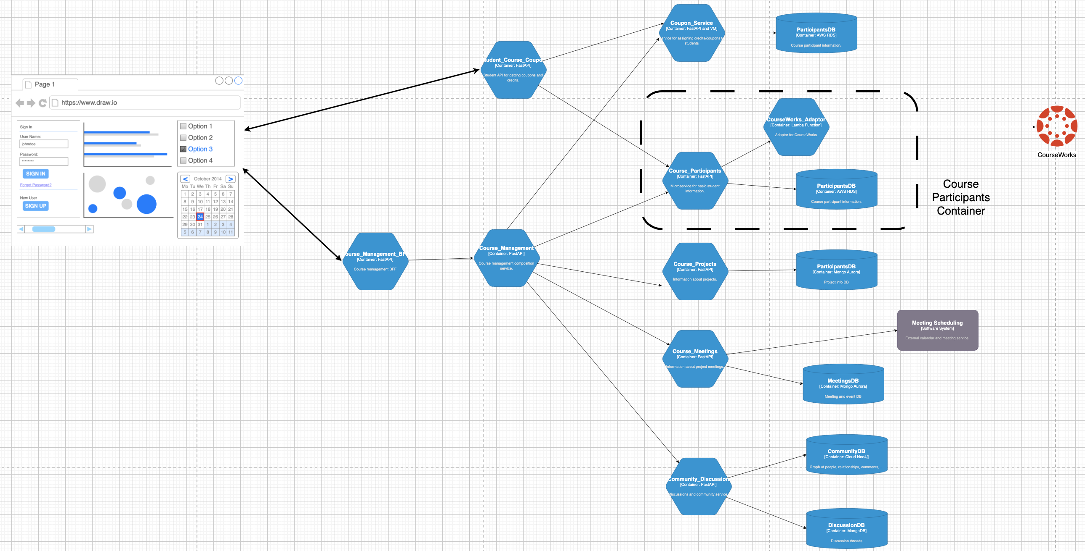
Microservice Application

Slide 82
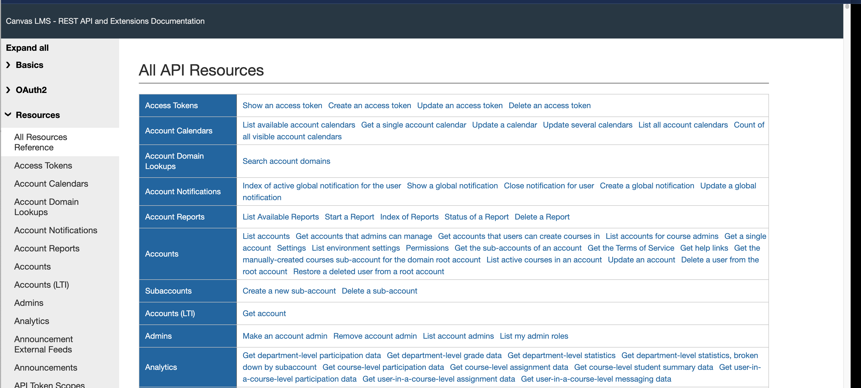
CourseWorks Canvas API

Slide 83
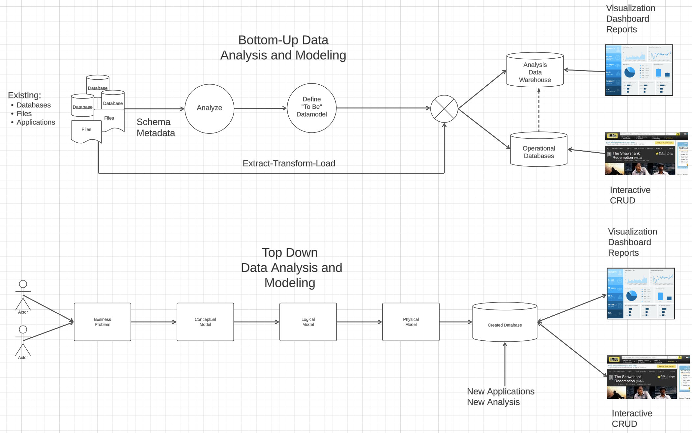
Data Modeling and Engineering

Slide 84
Data “Engineering” Pipeline
The CourseWorks API:
Returns a big, complex JSON document for each Course-Section
Returns a bigger, more complex JSON document containing students in Course-Section.
I need to transform the data:
Remove uninteresting information for my application.
Define to be relational model.
Load the data.
Show some of the notebook functions and underlying Python scripts.

Slide 85
Interactive Demo
/Users/donald.ferguson/Dropbox/000/00-Current-Repos/student-course-application/courseworks-adaptor-service/adaptor/courseworks_data_processing.ipynb
Interactive application:
/Users/donald.ferguson/Dropbox/000/00-Current-Repos/student-course-application/course-section-example
/Users/donald.ferguson/Dropbox/000/00-Current-Repos/student-course-application/dff_framework

Slide 86
End of Lecture
HW0 and HW1 will come out over the weekend.
86 | COMS W4111_003_2024_3: Lecture 1: Introduction, Course Overview, Foundational Concepts © Donald F. Ferguson, 2024

